Slide 1
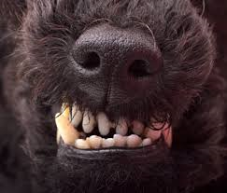
Rabies
THE RABIED KILLER
BY: Nicholas Mallard

Slide 2
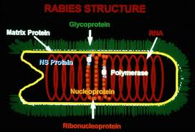
What are raBies ?
Rabies is a deadly virus that attacks the central nervous system and causes acute encephalitis. It is transmitted from animals to humans(zoonotic), most commonly by animal bites-although, there have been cases of humans becoming infected in bat caves after breathing in the air. Rabies infection is nearly always fatal unless prompt treatment is administered before the symptoms begin.

Slide 3
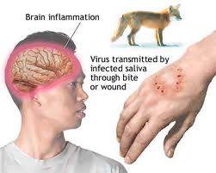
HOW CAN Rabies be transmitted ?
ANIMAL BITES
SALIVA GLANDS
SCRAT WOUNDS

Slide 4
History of the rabies virus
CULTURAL IMPACT OF THE VIRUS
CULTURAL REFRENCES OF THE VIRUS
Because of its potentially violent nature, rabies has been known since 3500 B.C.
The first writtren records of rabies is I n the Cordex of Eshnunna (ca. 1930BC), which dictates that the owner of a dog showing symptoms of rabies should take preventive measure against bites.
If a person was bitten by a rabid dog and later died, the owner was fined a huge amount.
“Cujo”, a Stephen King novel and film about a mother and her son being terrorized by a rabid dog.
“ I Drink Your Blood” a 1970s cult horror film about a gang of Satanic hippies who get infected by rabies.
“Quarantine”,a Hollywood horror movie about mutated variation of rabies.

Slide 5
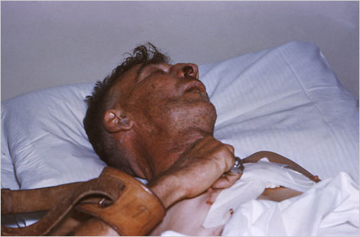
What are the symptoMs of rabies infections?
Signs of rabies
A person with the rabies virus
Progressive Anxiety
Stiff neck
Seizures
Overproduction of tears and saliva
Dilated pupils
Photophobia
Hallucinations
Insomina
Partial paralysis

Slide 6
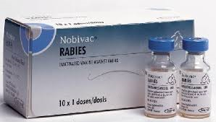
How to treat symptoms of rabies
Wash animal attacked wound or wounds immediately.
See a doctor immediately before considering additional vaccinations for the wound.
A series of rabies vaccines can help your body identify and fight the rabies virus. Rabies vaccines are given as injections in your arm. You will receive a least five injections over fourteen days.

Slide 7
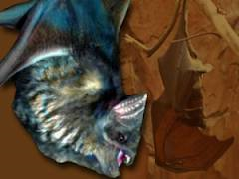
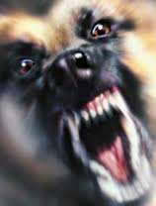
Animals with the Rabies virus
BATS
RACCOONS
DOGS
POSSOMS
FOXS
SQUIRRELS
CATS
SKUNKS
WEASELS
RATS
WOLVES

Slide 8
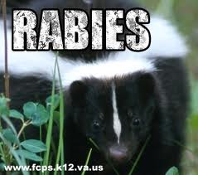
WAYS TO PREVENT THE SPREAD OF RABIES
If you have a pet make sure you get your pet the proper vaccination treatments it needs.
Maintain control of your pets to reduce their exposure to wildlife.
Spay or neuter to decrease the number of stray animals .
Report any spray or ill animals to animal control

Slide 9
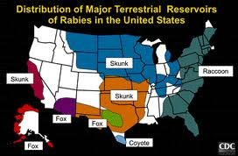
MAJOR AREAS IN UNITED STATES THAT CONTAIN LARGE AMOUNTS OF RABIES INFECTED ANIMALS

Slide 10
RABIES LAWS
MOST STATES HAVE LAWS MADATING RABIES VACCINATIONS FOR BOTH DOGS AND CATS.
MOST STATES ALSO HAVE LAWS REQUIRING RABIES QUARANTINE FOR ANIMALS THAT HAVE BITTEN A PERSON OR ANOTHER ANIMAL.
SOME STATES ALSO HAVE MANDATORY RABIES QUARANTINE FOR UNVACCINATED PETS WHO HAVE BEEN BITTEN BY A WILD ANIMAL OR WHO HAVE A SUSPECTED BITE WOUND OF UNKNOWN ORIGIN.

Slide 11
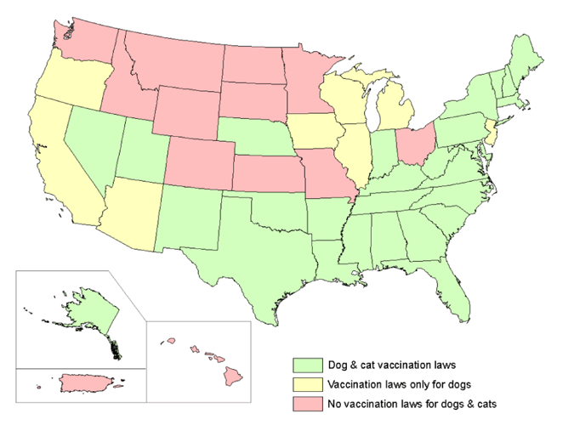
Rabies laws for each state

Slide 12
Can PEOPLE GIVE OTHER PEOPLE RABIES?
THIS HAS ONLY OCCURRED IN A SMALL NUMBER OF CASES AFTER TRANSPLANTS(CORNEAS, LIVER, KIDNEYS) FROM AN INFECTED PERSON. STRICTER GUIDELINES FOR ACCEPTANCE OF DONOR ORGANS HAVE BEEN ADOPTED AS A RESULT OF THESE CASES.
IN THEORY, INFECTED HUMANS COULD TRANSMIT RABIES THROUGH A BITE OR OTHER EXPOSURE, BUT NO LABORATOR CONFIRMED CASES OF RABIES IN THIS WAY HAVE BEEN REPORTED.

Slide 13
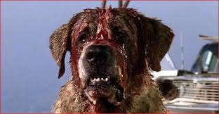
Beware of these rabid jaws!

Slide 14
Video on how CAN rabies can affect us!
Rabies: How Vaccinations Help For Pets Exposed To Deadly Disease - YouTube

